Slide 1

BIONIC ARM
SIMULATION & CODE IMPLEMENTATION
Mentored by: Dr. Mitresh Kumar Verma
Indian Institute of Technology (BHU) Varanasi

Slide 2
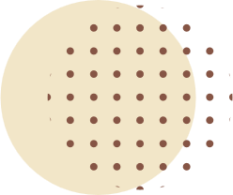



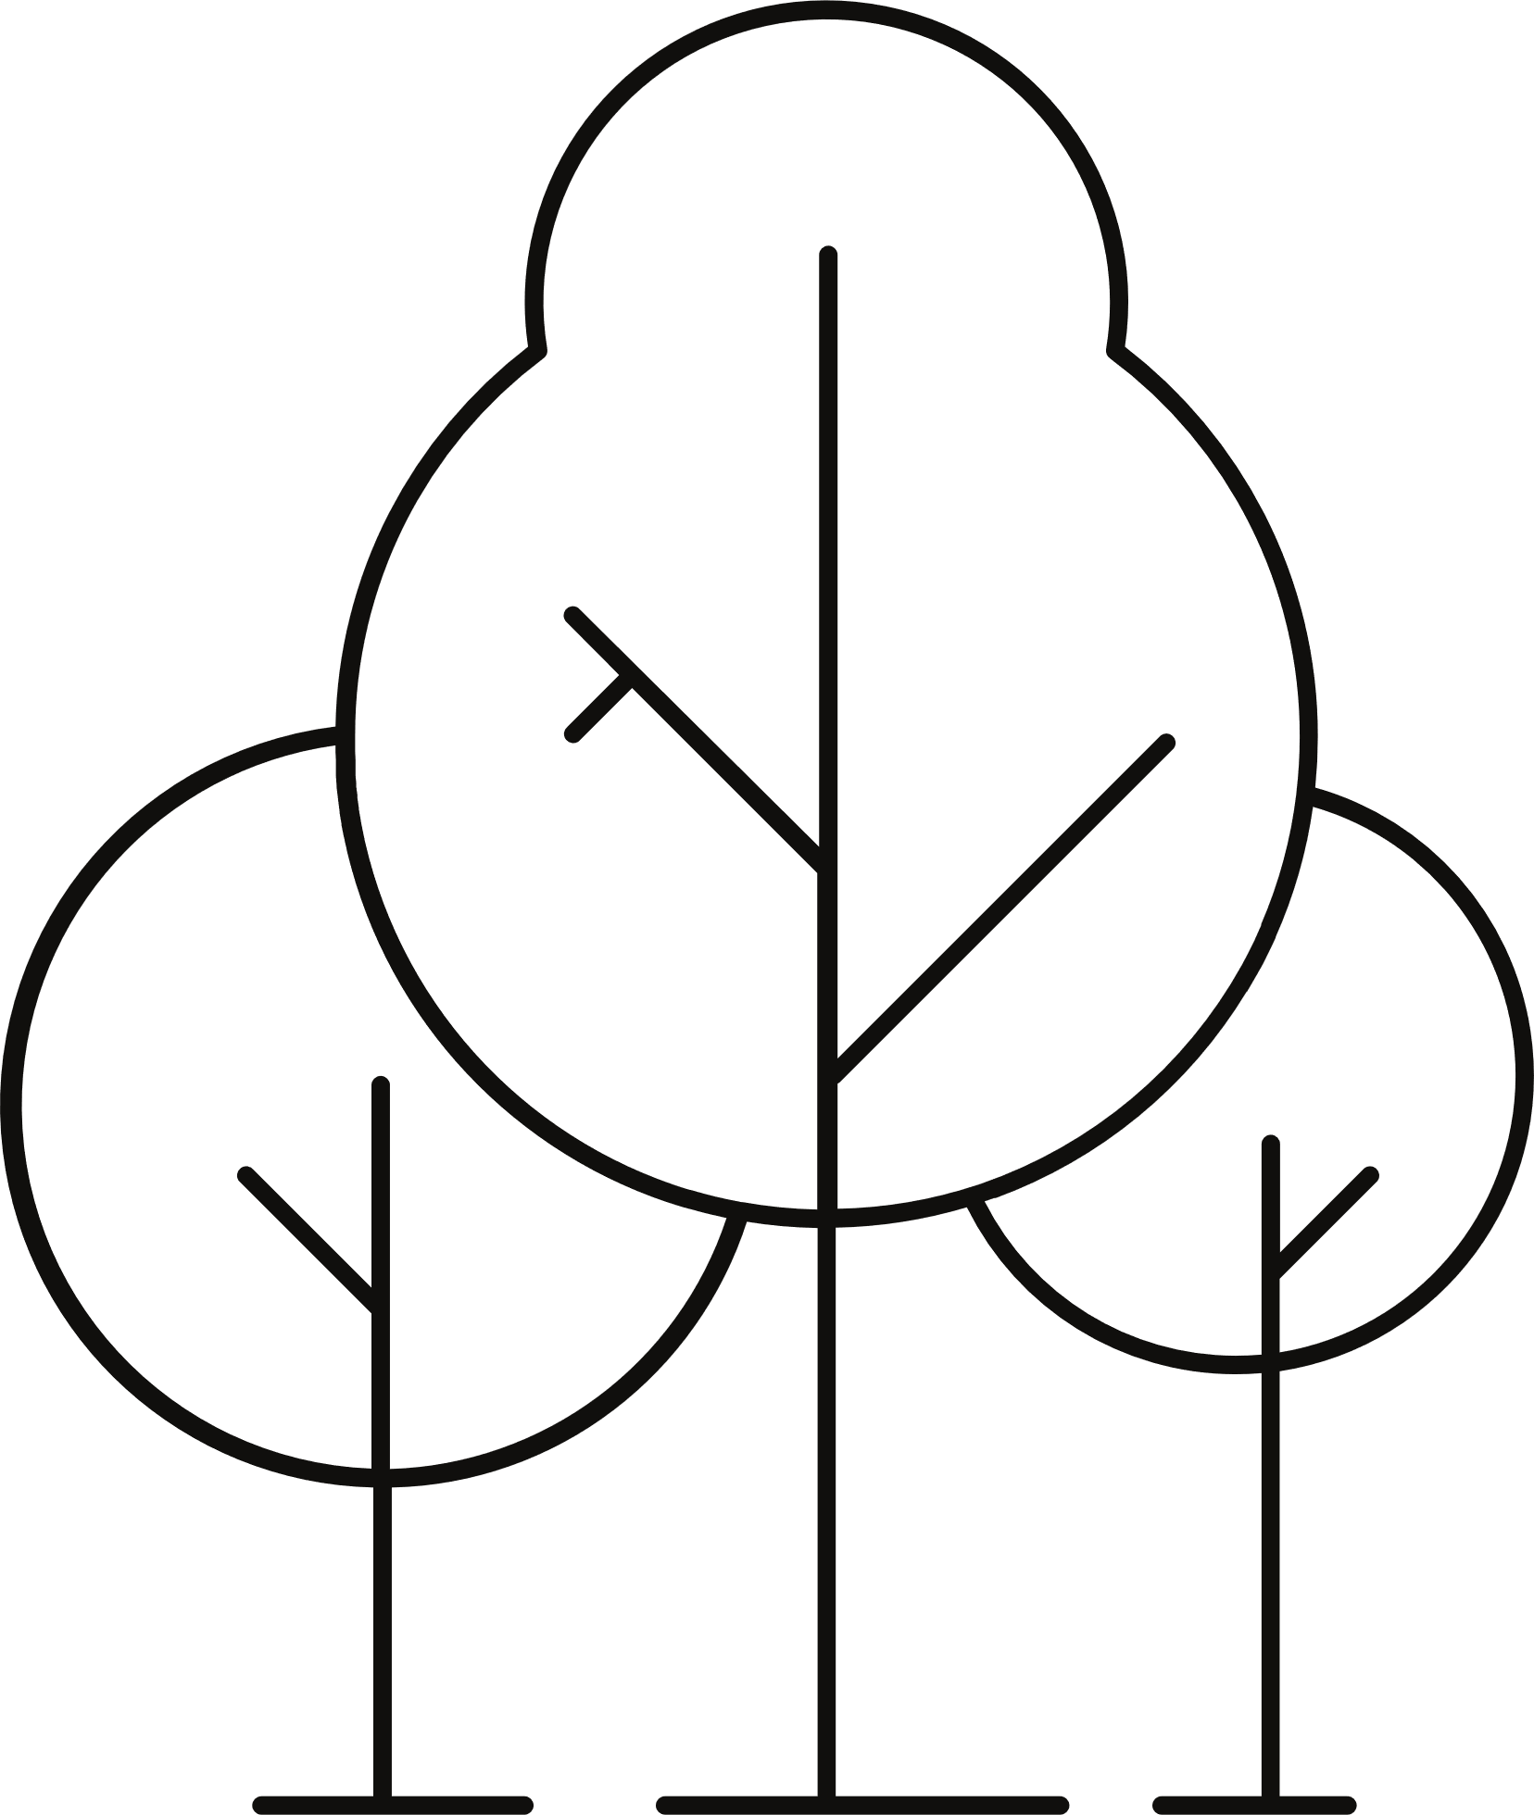

PROJECT MOTIVATION & BACKGROUND
Modern bionic arms offer improved dexterity over traditional passive prosthetics
Simulation enables safe, cost-effective testing of control algorithms and mechanical designs
Builds on research in sensor gloves and prosthetic control systems
Allows for iterative design and validation before committing to hardware
Addresses the need for more natural, user-friendly assistive technology

Slide 3
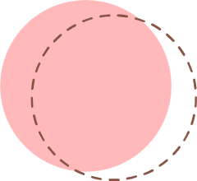

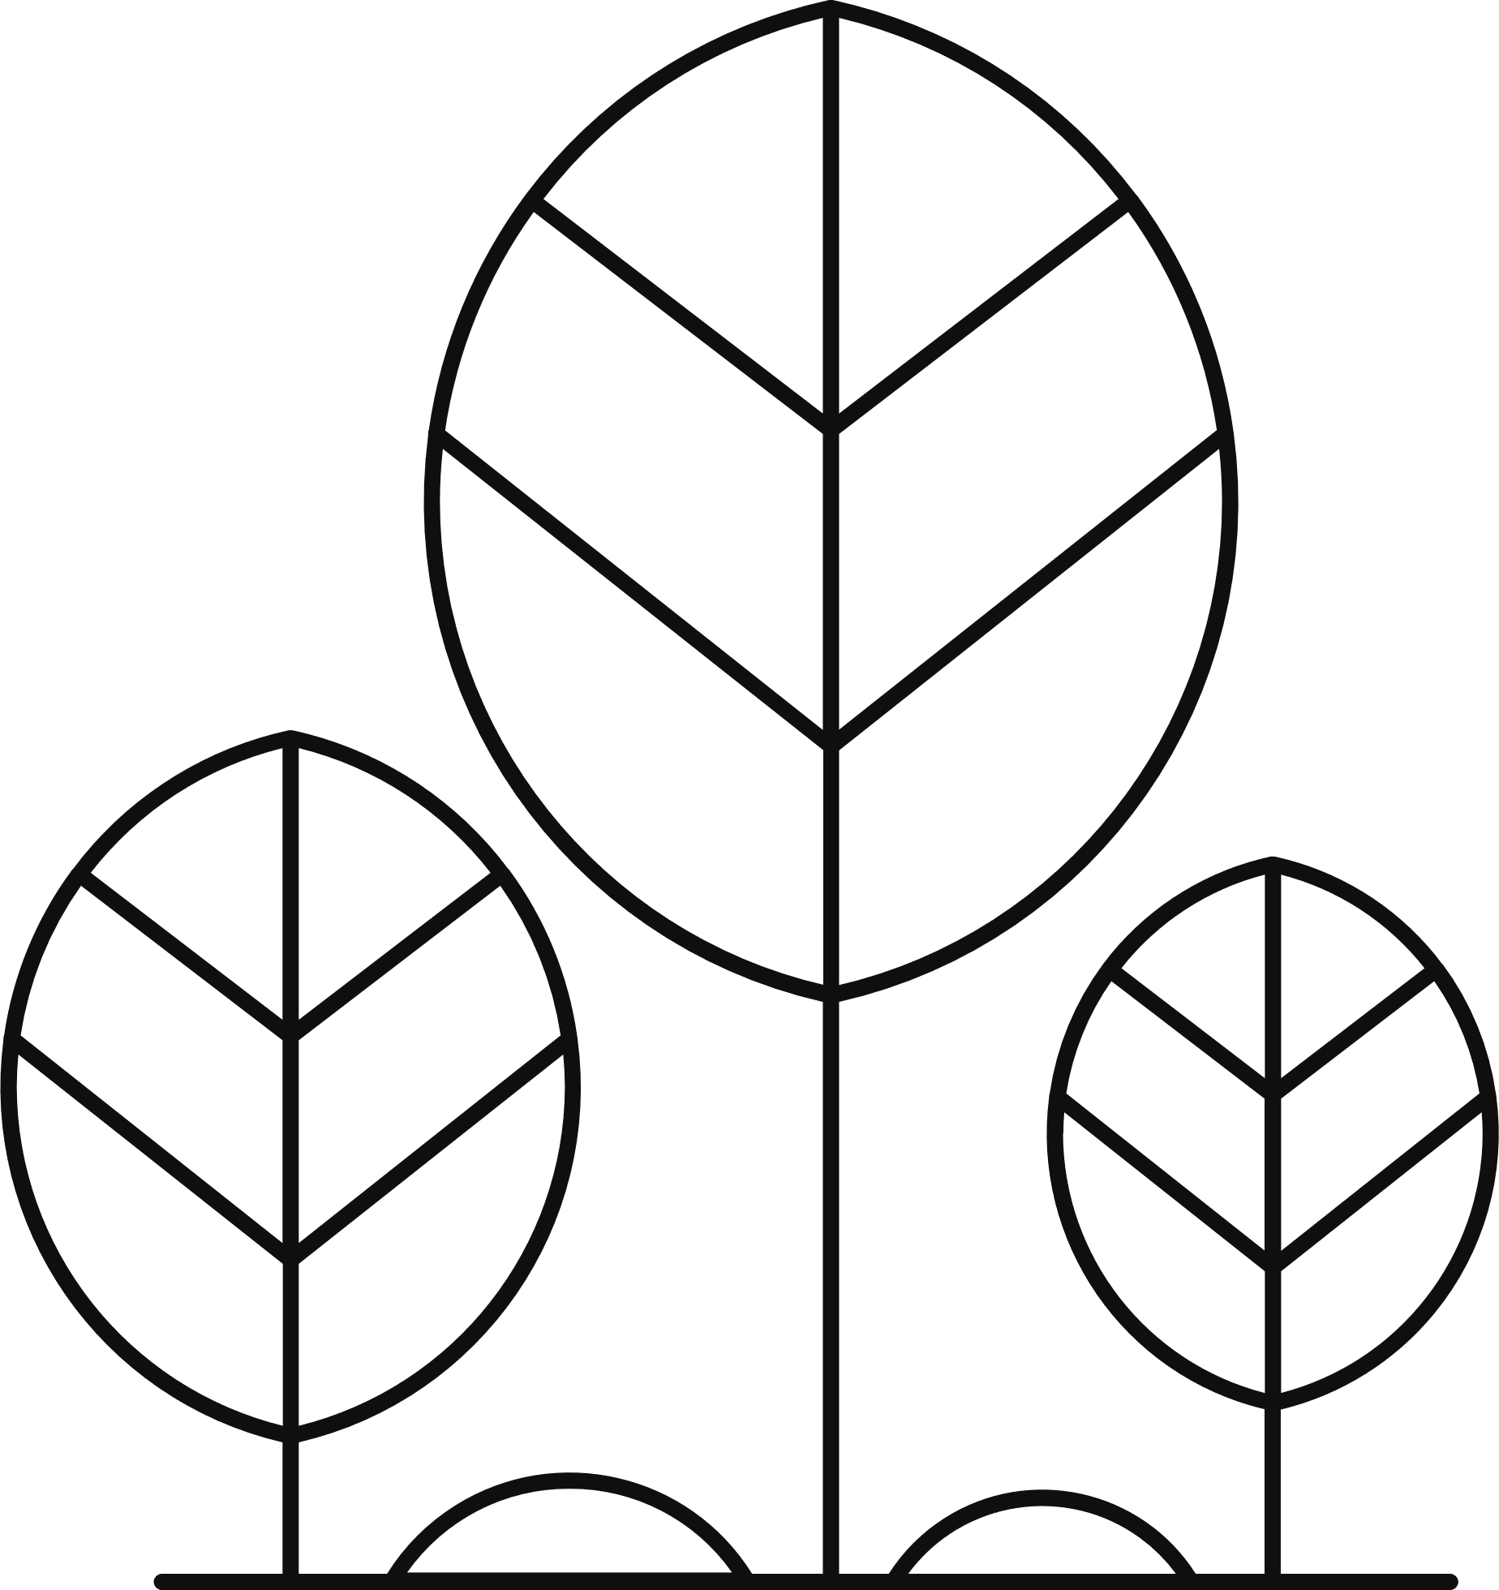


PROJECT OVERVIEW
Aims to design a prosthetic limb controlled via a wearable glove interface
Project structured in two phases:
Phase 1: Simulation using PyBullet to create and validate a virtual bionic arm
Phase 2: Planned physical prototyping based on simulation results
Virtual model includes palm, fingers, and forearm with realistic joint constraints
Grasping and pinching functions successfully demonstrated in simulation
Sets the foundation for real-time sensor glove integration and hardware fabrication

Slide 4


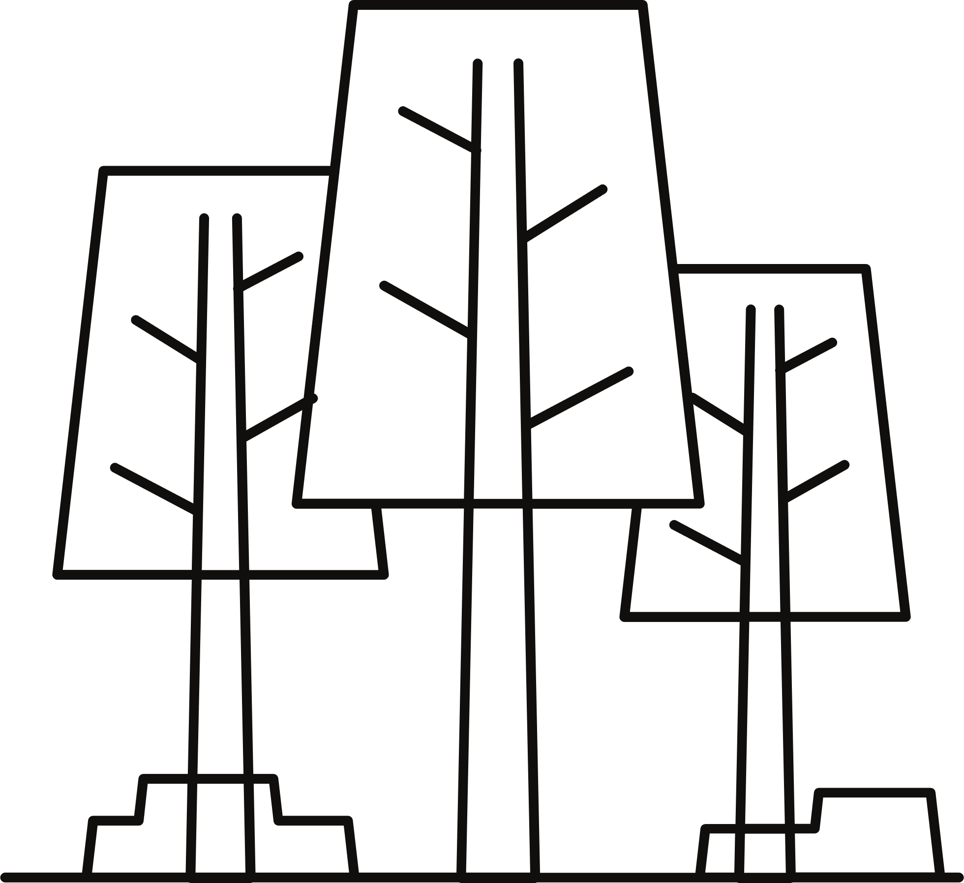

SIMULATION ENVIRONMENT
Built on PyBullet physics engine for accurate rigid-body dynamics and collision detection
Environment setup includes:
Ground plane as the base surface
Manipulable object (sphere or cube) for grasping and pinching tests
18-joint bionic hand model anchored in space (simulating a prosthetic)
Self-collision detection enabled for realistic finger interactions
Visual, interactive simulation provides immediate feedback for code and design changes

Slide 5


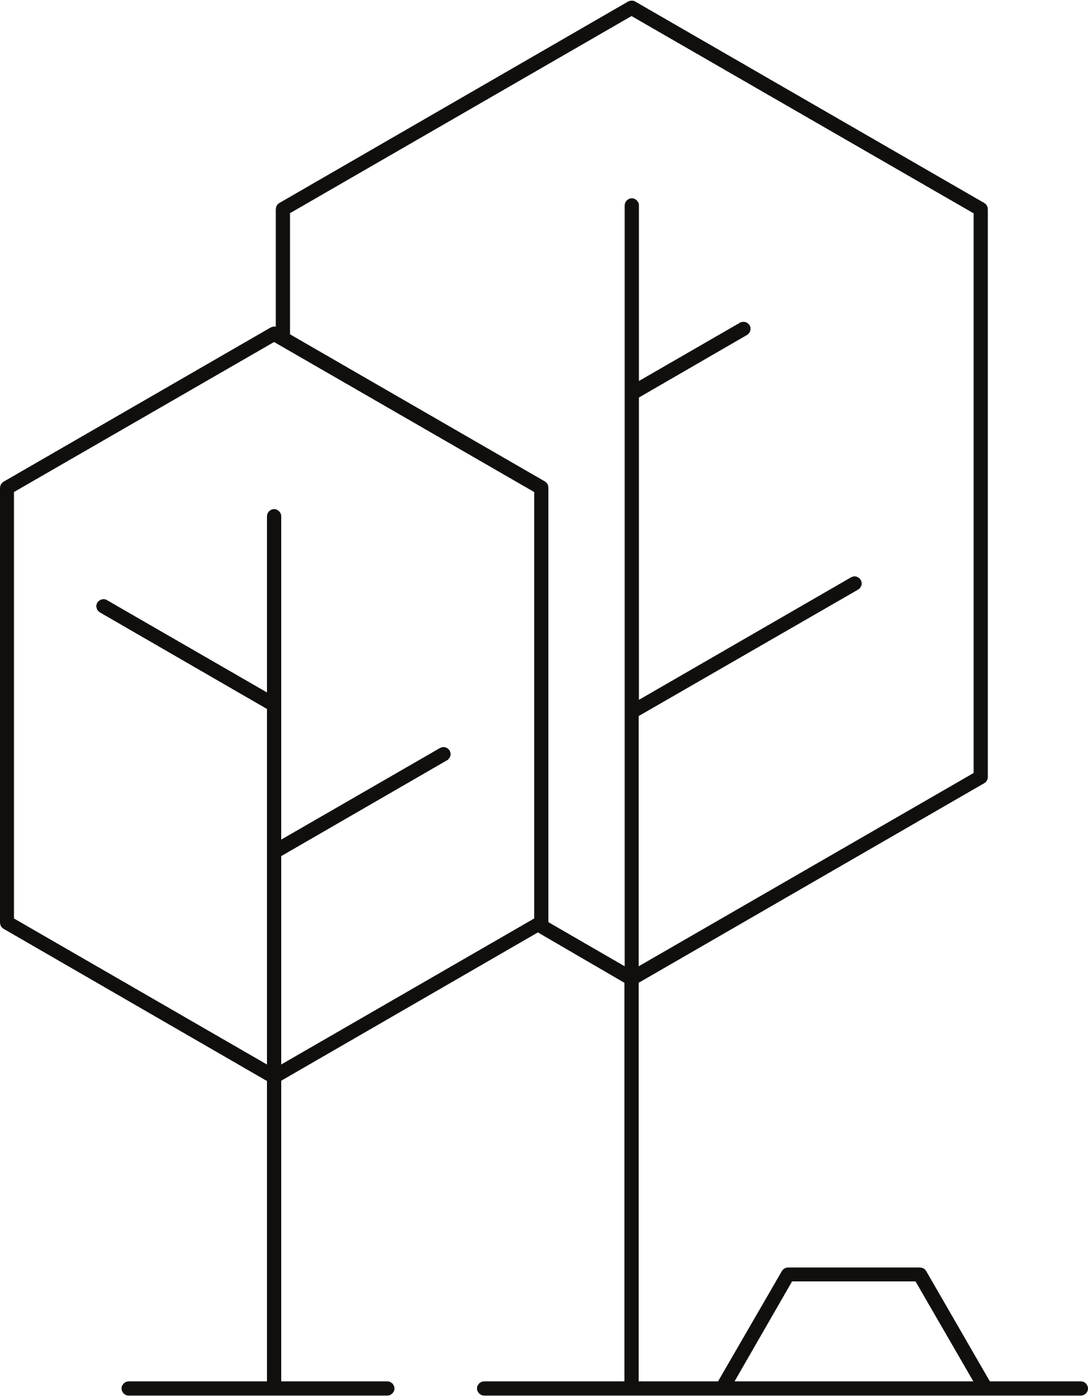

HAND MODEL & JOINT STRUCTURE
Hand model structured with 18 joints for high dexterity:
2 forearm tilt joints (for arm orientation)
1 wrist joint (rotation)
3 joints per finger (index, middle, ring, pinky) for base, middle, and tip movement
3 thumb joints (lateral base and two curl joints)
Hierarchical joint mapping allows coordinated and individual finger control
Joint organization mimics human hand anatomy for natural motion
Helper functions in code enable easy access and control of finger joints

Slide 6
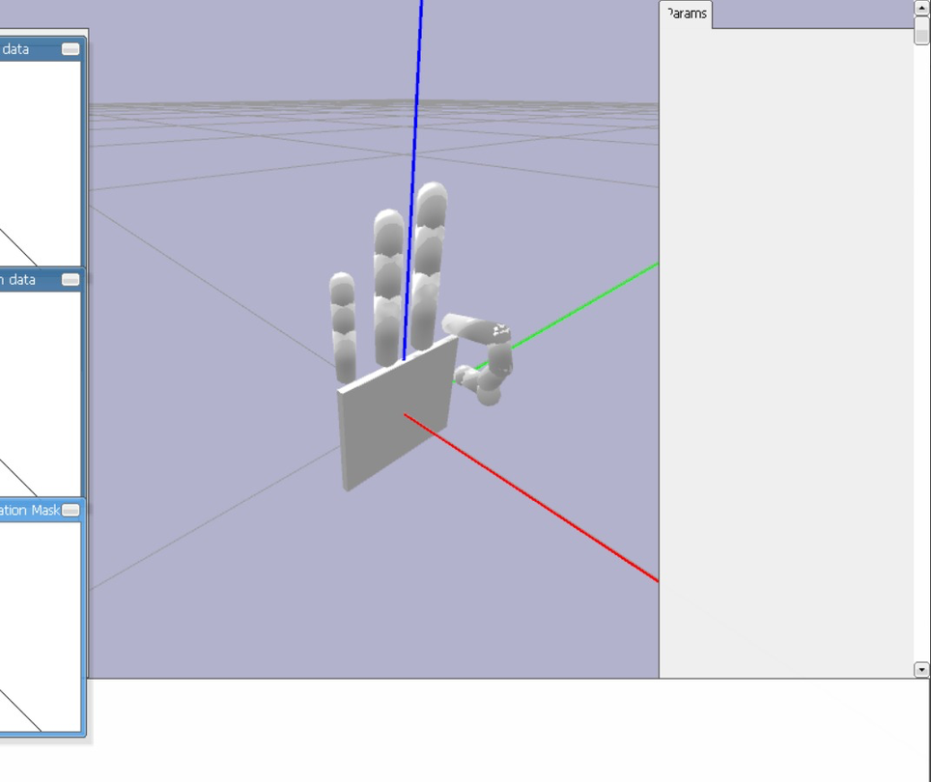
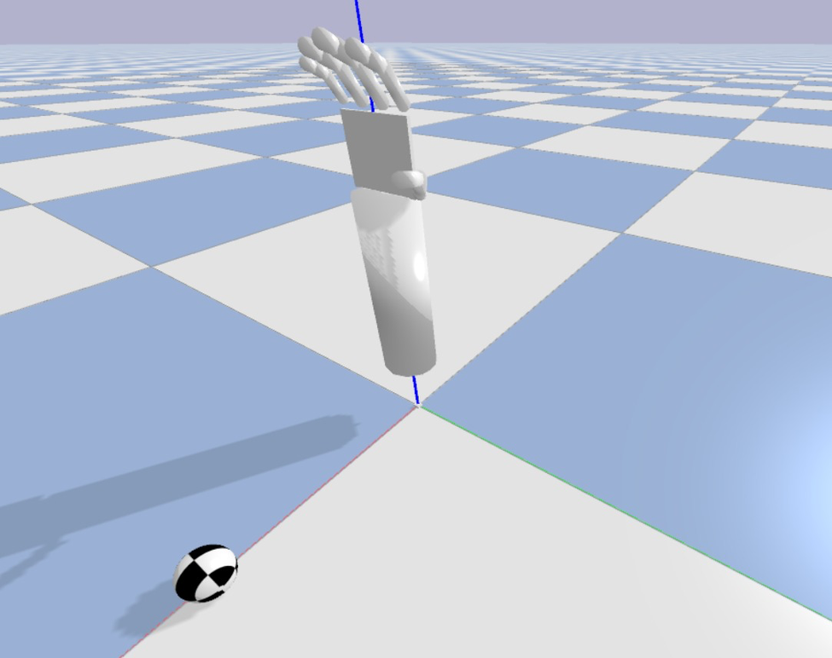
HAND MODEL & JOINT STRUCTURE

Slide 7
USER INTERFACE & KEYBOARD MAPPING
Extensive keyboard mapping for intuitive control:
Keys assigned for forearm, wrist, individual fingers, and thumb movements
Dedicated keys for synchronized grasping and pinching actions
Keyboard events polled at simulation rate (240 Hz) for real-time responsiveness
Interface supports thorough testing of all control algorithms and gestures
Code structured to allow future integration with sensor glove inputs

Slide 8
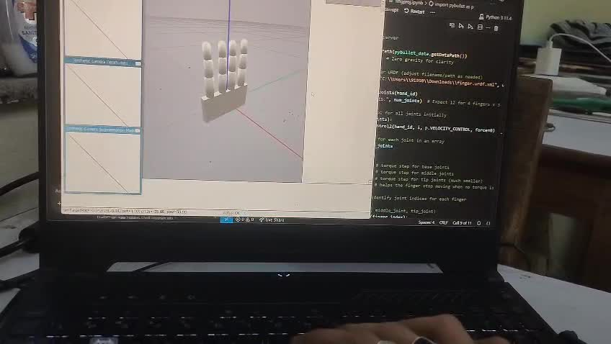
KEYBOARD MAPPING

Slide 9
CONTROL SYSTEM IMPLEMENTATION
Position control: Target positions for each joint incrementally adjusted based on user input
Step sizes for joint movement tuned for different sensitivity needs (e.g., smaller for fingertips)
Every joint link has an inbuilt closed loop servo motor which responds to the desired position given as input.
Friction parameters set for each joint and object to prevent slippage during manipulation

Slide 10
GRASPING & PINCHING FUNCTIONS
Synchronized grasping: All fingers close together using a grasp_state variable (0.0 = open, 1.0 = closed)
Precision pinching: Index finger and thumb coordinated for fine object manipulation with pinch_state
Closed positions for each joint calibrated for effective grasp and pinch
Incremental updates to grasp/pinch state enable smooth, gradual transitions
Functions implemented in code allow for both individual and combined gestures

Slide 11
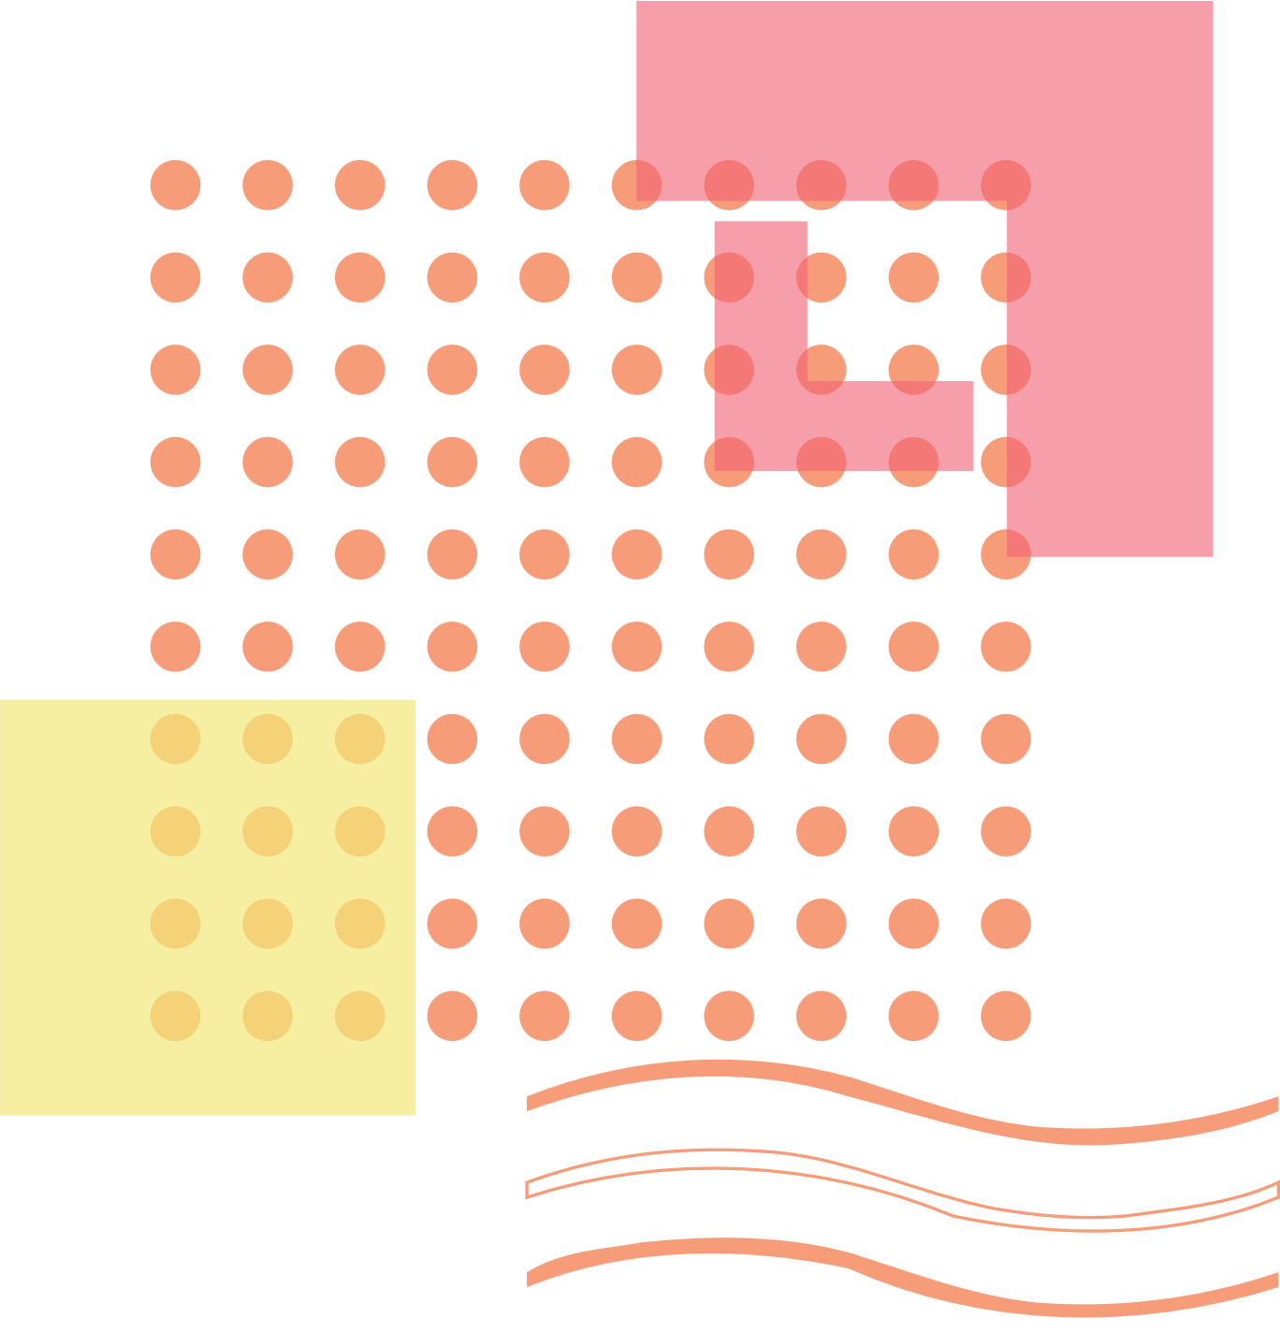
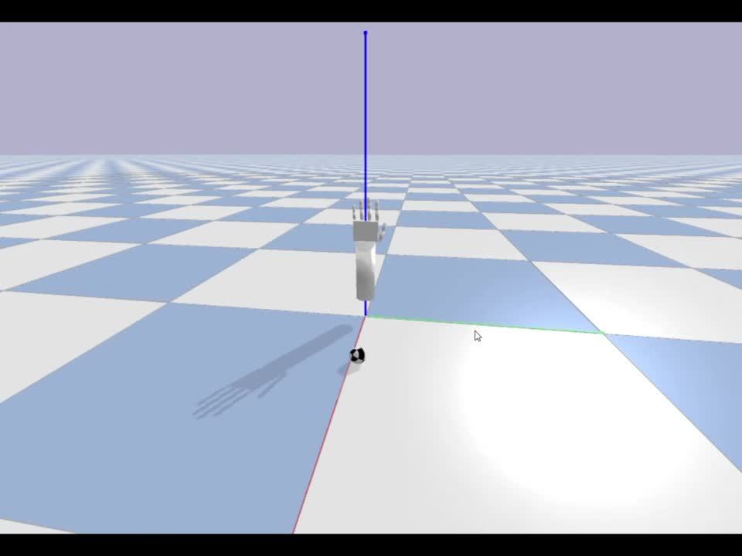
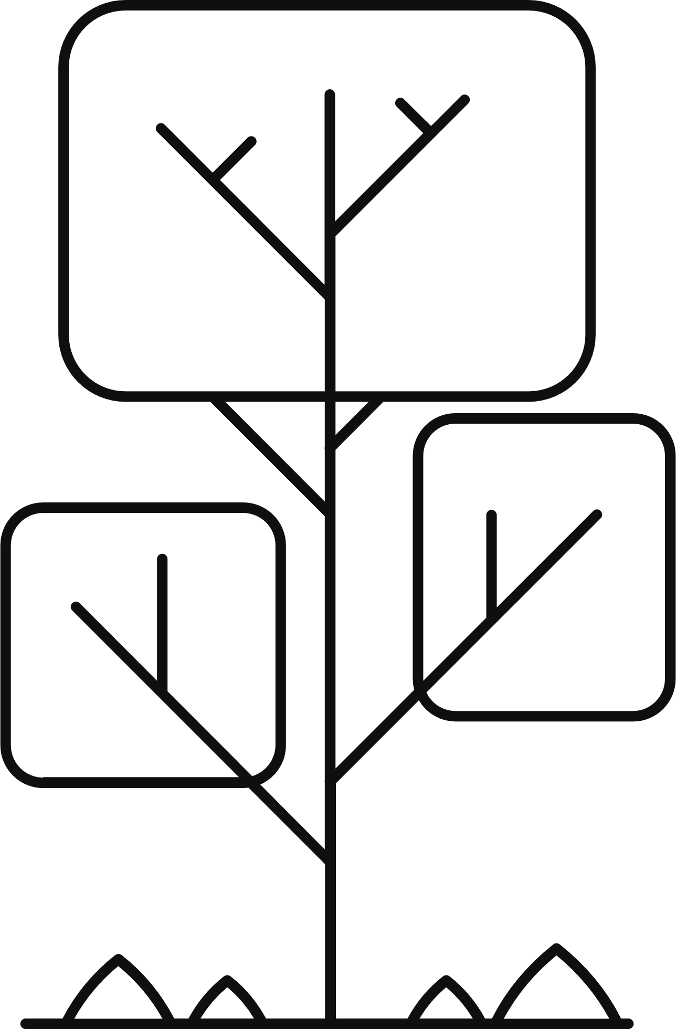

PICKING UP AN OBJECT

Slide 12
FUTURE WORK
Future plans include:
Developing a sensor glove with flex sensors and Arduino Nano
Calibration of sensor data to joint angles for real-time control
Physical prototype fabrication based on validated simulation model
Modular codebase designed for easy extension and adaptation

Slide 13
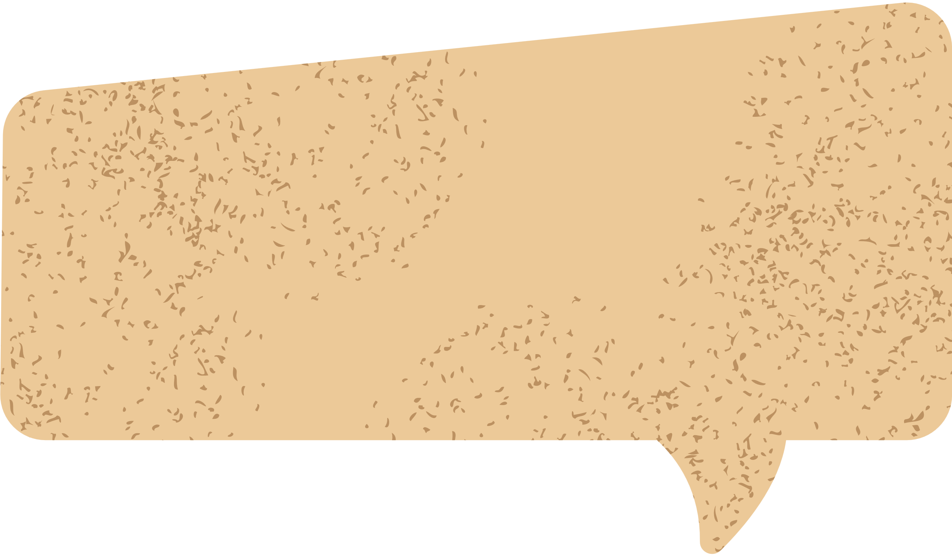
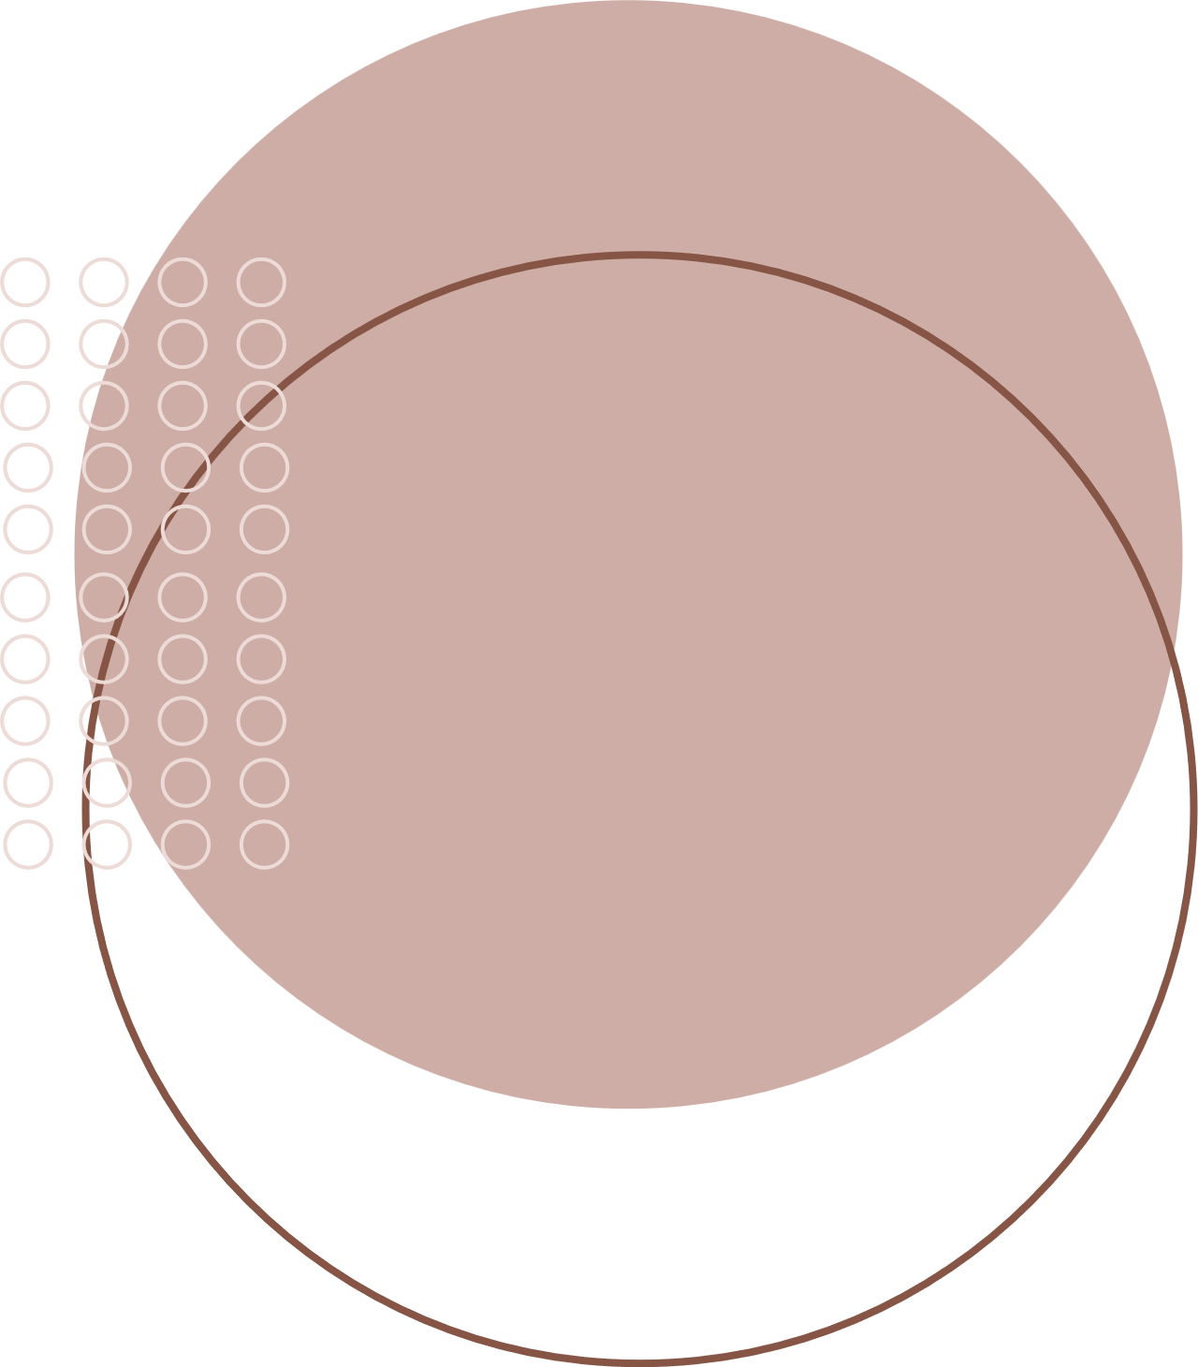

QUESTIONS
&
ANSWERS

Slide 14
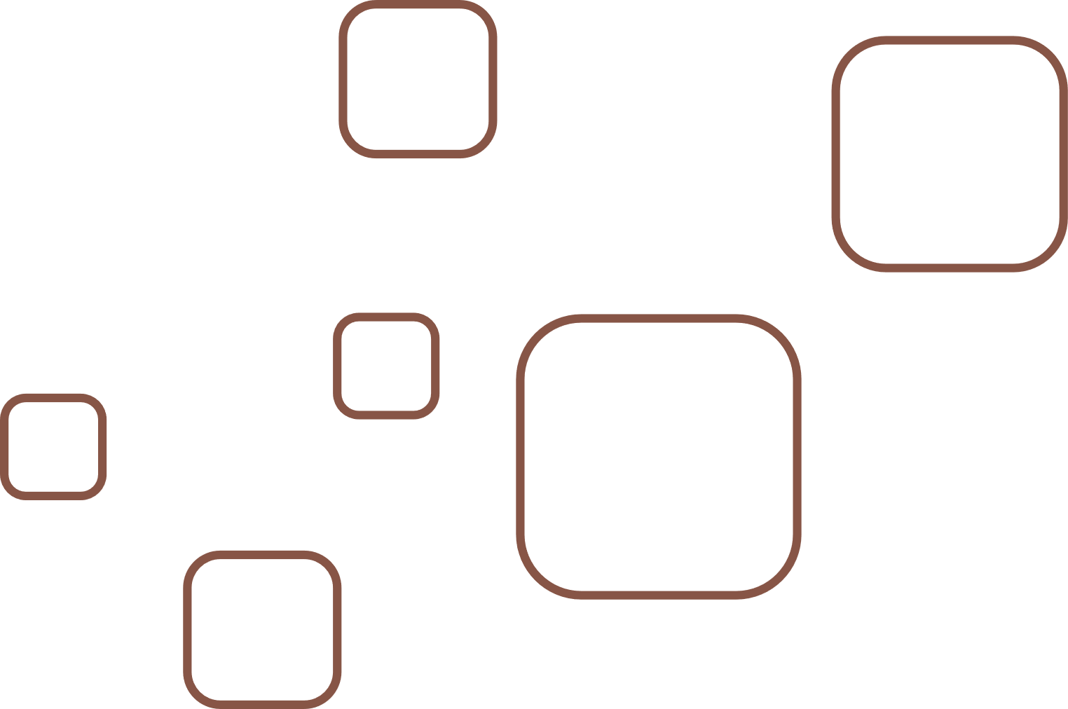



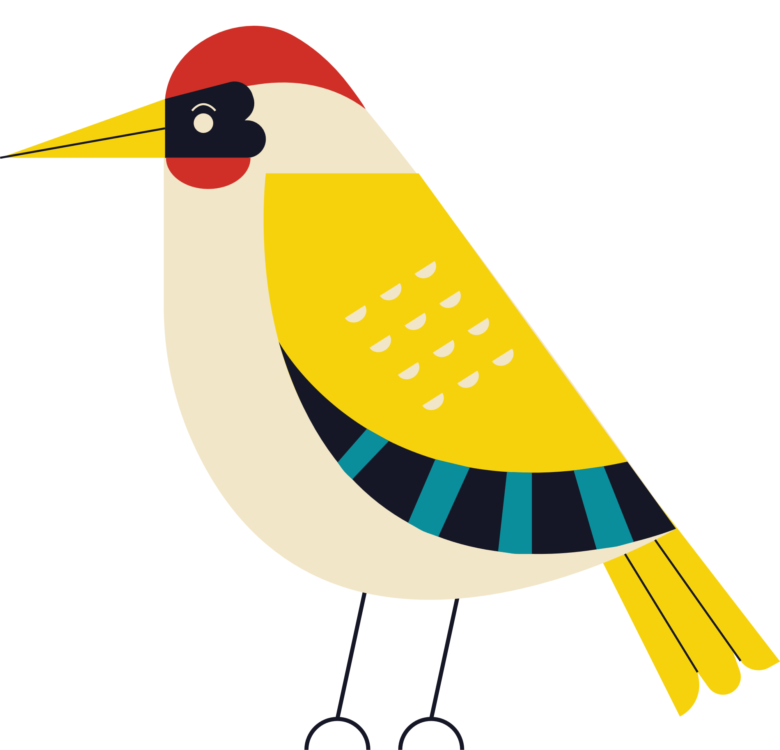
THANK
YOU
Aayush | Abhinav Jaiswal | IIT BHU | 2025

